Slide 1
FC Accreditation 2017
Everything you didn’t know you wanted to know!

Slide 2
Standard I

Slide 3
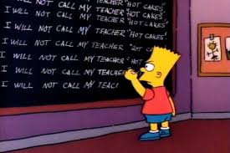
Standard II A

Slide 4
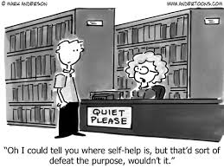
Standard IIB

Slide 5
Standard IIC

Slide 6
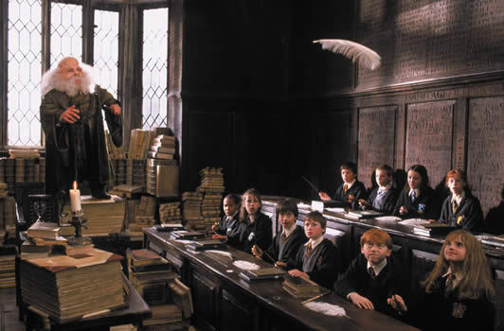
Standard III

Slide 7
Standard IV

Slide 8
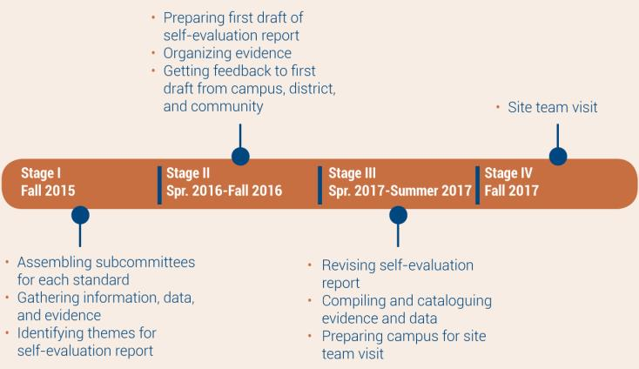
Timeline

Slide 9
2011 ACCJC Accreditation Report Quiz
Choose the best answer from those provided and write it in your program.

Slide 10
Question #1
The 2011 report said which of these about the NOCCCD budget allocation model?
The model should be more clearly delineated and linked to district planning.
The plot of Inception was easier to follow.
The model ensured yearly budget deficits.
It was neither budgetary, nor allocative, nor a model.
.

Slide 11
Question # 2
The 2011 report singled out the Library, Academic Support Center, Veterans Services Office, EOPS, the Cadena Cultural Center, and the Diversity Committee for which of these?
Having the best snacks at meetings
Having a wide variety of innovative programs in support of student development, engagement, and success
Having students involved in planning
Having exemplary program review self-evaluations

Slide 12
Question #3
What did the 2011 report say about the way we communicate with our Fullerton College colleagues?
OMG. LOL. SMH. ☹
We should be sending out more email newsletters .
We can probably stop updating our MySpace page now.
We have a tradition of collegial discourse that enables constructive dialogue

Slide 13
Question #4
Which of the following aspects of Fullerton College’s new facilities did the 2011 report say needs to be incorporated into the college’s planning and budget models?
One-time construction costs
Total cost of ownership
The margin of victory in all bond measures supporting facility improvements
Naming rights for large corporations: e.g., Disney Presents the 300 Building

Slide 14
And your final question
The 2011 report recommended the college do what with the results of Student Learning Outcome Assessment?
Shred to make confetti for FC’s bicentennial celebration
Make improvements in courses and programs
Carve them into granite tablets and display on the Quad
Design student intervention plans

Slide 15
The answers

Slide 16
Question #1
The 2011 report said which of these about the NOCCCD budget allocation model?
The model should be more clearly delineated and linked to district planning.
The plot of Inception was easier to follow.
The model ensured yearly budget deficits.
It was neither budgetary, nor allocative, nor a model.

Slide 17
Question # 2
The 2011 report singled out the Library, Academic Support Center, Veterans Services Office, EOPS, the Cadena Cultural Center, and the Diversity Committee for which of these?
Having the best snacks at meetings
Having a wide variety of innovative programs in support of student development, engagement, and success
SOMETHING FUNNY
Having exemplary program review self-evaluations

Slide 18
Question #3
What did the 2011 report say about the way we communicate with our Fullerton College colleagues?
OMG. LOL. SMH. ☹
We should be sending out more email newsletters .
We can probably stop updating our MySpace page now.
We have a tradition of collegial discourse that enables constructive dialogue

Slide 19
Question #4
Which of the following aspects of Fullerton College’s new facilities did the 2011 report say needs to be incorporated into the college’s planning and budget models?
One-time construction costs
Total cost of ownership
The margin of victory in all bond measures supporting facility improvements
Naming rights for large corporations: e.g., Disney Presents the 300 Building

Slide 20
And your final question
The 2011 report recommended the college do what with the results of Student Learning Outcome Assessment?
Shred to make confetti for FC’s bicentennial celebration
Make improvements in courses and programs
Carve them into granite tablets and display on the Quad
Design student intervention plans

Slide 21
How did you do?
0 Correct: You clearly need to learn a lot about your campus and the accreditation process, so you are now the next co-chair of the accreditation self-evaluation.
1-2 Correct: You also don’t know much about your campus, but you must be a decent guesser, which means you will be perfect for helping decipher hand-written minutes and meeting notes.
3 Correct: You are average. We need average people to keep the report real and dope and fresh.
4 Correct: You are nearly perfect, which means you are good at spotting errors in the work of others.
5 Correct: Why are you sitting down there? You belong up here with the steering committee.

Slide 22
Meet the FC Accreditation 2017 Team
Steering Committee co-chairs:
Jose Ramon Nunez, VPI and ALO
Danielle Fouquette, Humanities, faculty co-chair
Steering committee resource members:
Carlos Ayon, Researcher
Pete Snyder, Faculty Senate president
Standard I co-chairs
David Grossman, Dean of PE
Doug Eisner, Humanities
Standard II chair
Mark Greenhalgh, Dean of Math and Computer Science
Standard II A co-chairs
Dan Willoughby, Dean of Humanities
Mike Mangan, Humanities
Standard II B&C co-chairs
Dani Wilson, Dean of Library…
Joe Carrithers, Humanities
Standard III co-chairs
Richard Storti, VPAS
Marcus Wilson, Business
Standard IV co-chairs
Savannah Jones, VPSS
Josh Ashenmiller, Social Sciences

Slide 23
There may be no “team” in accreditation…
…but it ends with an ion, and because science is weird, a negative ion is actually better than a positive one for helping us be energized.

Slide 24
Q: How do we make ions negative (which is good)?
A: Add a negative electron.

Slide 25
Q: Who will be our negative electron?
A: That’s easy.
Joe Carrithers
Everyone else is charged with staying positive.

Slide 26
Breakout sessions
Standard I: Room 22X
Standard IIA: Room 22X
Standard IIB: Room 22x
Standard III: Room 22x
Standard IV: Room 22x

